Slide 1
Conversational Interface for Multi-Source Information Retrieval
Abhiyan Sainju
Balaji Senthilkumar

Slide 2
Introduction
Challenges of information overload from multiple sources
Inefficiency of manual searching and filtering
Results in frustration and lost productivity
Underutilization of audio content due to lack of efficient tools
Our project aims to streamline information retrieval process

Slide 3
Project Overview

Slide 4
Project Overview
Conversational interface for querying multiple sources of information including PDFs, YouTube videos, and audio recordings
Leverages NLP, vector databases, large language models
Allows users to interact with information efficiently using context memorization

Slide 5
Core Features
Text extraction from PDFs, YouTube transcripts, audio files
Vector embedding and storage in vector databases
Conversational query interface to interact with the information present in PDFs, YouTube videos and audio files.
Integration of online (GPT-3.5-turbo) and offline (Mistral) language models

Slide 6
System Architecture
User options: PDF Chat, Audio Chat, Lecture Chat, YouTube Chat, Offline Chat
Files processed to extract text/transcripts and convert to embeddings
Embeddings stored in respective vector databases (FAISS or Chroma)
User enters query in conversational chat interface
Query embedded and matched to similar embeddings in vector store
Top result sent to language model (GPT-3.5-turbo or Mistral) to generate response
Response displayed in chat, maintaining conversation history/context

Slide 7
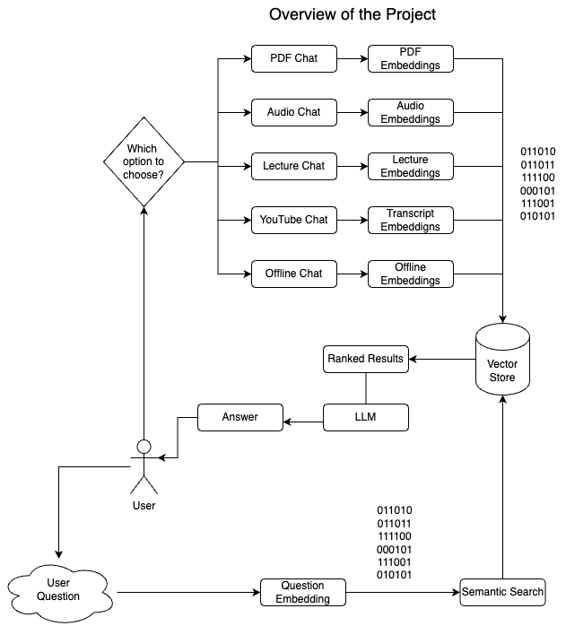
How our System Works
7

Slide 8
Implementation Details
Text extraction using PyPDF2, chunking with CharacterTextSplitter
Embeddings with OpenAIEmbeddings (online), OllamaEmbeddings (offline)
Vector stores: FAISS (online), Chroma (offline)
Conversational interface using ConversationalRetrievalChain, ConversationBufferMemory components

Slide 9
Youtube Video Processing
Use youtube-transcript-api to fetch video transcript
Extract video id from YouTube link using regex
Process transcript text like PDF files
Generate embeddings and store in vector database
Allow querying video content via chat

Slide 10
Audio Processing
Record audio from user via browser
Convert to byte streams, store as temporary file
Use OpenAI's whisper-1 model for speech-to-text
Process transcript to create embeddings/vector store
Enable querying audio through chat interface

Slide 11
Offline LLM Integration
Use Mistral offline language model
Local processing, addresses privacy concerns
OllamaEmbeddings for local embedding generation
Chroma as offline vector store

Slide 12
Difficulties Faced
Maintaining session state for context memory, preventing conflicts
Dealing with deprecated libraries/code
Improving inference speed
Enabling GPU acceleration for offline model

Slide 13
Contributions and Achievements
Efficient multi-source information retrieval
Online and offline language model support
Contextual and conversational interactions
User-friendly interface with Streamlit
Time-saving and productivity enhancements

Slide 14
Future Work
Expanded source support (websites, databases, knowledge bases)
Multilingual audio support
Personalized query suggestions and result ranking
GPU acceleration for offline models

Slide 15
Thanks!
Any questions?

Slide 16
Credits
Presentation template by SlidesCarnival
Photographs by Unsplash
Illustrations by Undraw.co

